Slide 1


All Star
Smash Mouth

Slide 2
Smash Mouth
Smash Mouth is an American alternative rock band formed in 1994 in San Jose in California.
The band was founded by Steve Harwell and Kevin Coleman, who shortly there after joined with Greg Camp and Paul de Lisle

Slide 3

All Star
"All Star" is a single by Smash Mouth about a man remembering the things people have told him to motivate him to become a rock star.
It was featured on their album Astro Lounge and is one of the group's most successful songs.

Slide 4

Soon after its release the song became quite ubiquitous in pop culture.
Mystery Men, it was included in the opening credits to the film Shrek.
The song was also featured in the soundtrack to Digimon: The Movie, Go Tigers!, and Inspector Gadget.

Slide 5
Contextualization
May 13 – A tornado category F6 hits Oklahoma in the USA, is the largest tornado ever recorded worldwide.
May 18 – Dias Gomes, playwright and writer of novels of Rede Globo, the husband of Janete Clair also a writer.
May 19 – Premiere of episode one of star wars “The Phantom Menece”.

Slide 6
All Star

Slide 7


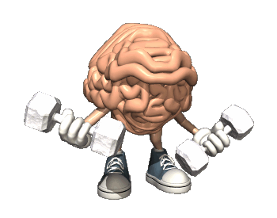
Somebody once told me the world is gonna roll me
I ain't the sharpest tool in the shed
She was looking kind of dumb with her finger and her thumb
In the shape of an "L" on her forehead
Well the years start coming and they don't stop coming
Fed to the rules and I hit the ground running
Didn't make sense not to live for fun
Your brain gets smart but your head gets dumb
So much to do so much to see
So what's wrong with taking the back streets
You'll never know if you don't go
You'll never shine if you don't glow

Slide 8
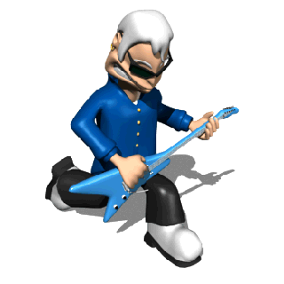
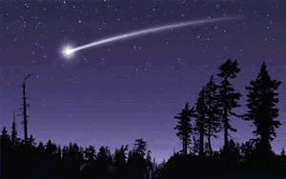
Hey now you're an All Star, get your game on - go play
Hey now you're a Rock Star, get the show on - get paid
And all that glitters is gold
Only shooting stars break the mold
It's a cool place and they say it gets colder
You're bundled up now but wait 'til you get older
But the meteor men beg to differ
Judging by the hole in the satellite picture
The ice we skate is getting pretty thin
The waters getting warm so you might as well swim
My world's on fire how about yours
That's the way I like it and I never get bored

Slide 9
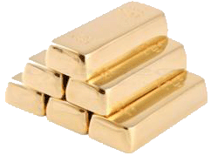
Hey now you're an All Star, get your game on - go play
Hey now you're a Rock Star, get the show on - get paid
And all that glitters is gold
Only shooting stars break the mold
Hey now you're an All Star, get your game on - go play
Hey now you're a Rock Star, get the show on - get paid
And all that glitters is gold
Only shooting stars

Slide 10

Somebody once asked could you spare
some change for gas
I need to get myself away from this place
I said yep what a concept
I could use a little fuel myself
And we could all use a little change
Well the years start coming and they don't stop coming
Fed to the rules and I hit the ground running
Didn't make sense not to live for fun
Your brain gets smart but your head gets dumb
So much to do so much to see
So what's wrong with taking the back streets
You'll never know if you don't go (go)
You'll never shine if you don't glow

Slide 11

Hey now you're an All Star, get your game on - go play
Hey now you're a Rock Star, get the show on - get paid
And all that glitters is gold
Only shooting stars break the mold
And all that glitters is gold
Only shooting stars break the mold

Slide 12
Contractions
Contractions are a faster way to talk
Something through the junction and abbreviation of two words that are in sequence.
Contractions almost always use of apostrophe ‘ to separete words.
Ex.:
You'll never know if you don't go = You will never know…
Hey now you're an All Star = Hey now you are an All Star

